Slide 2
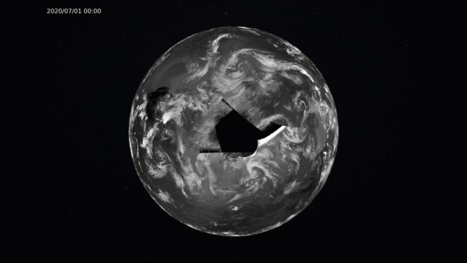
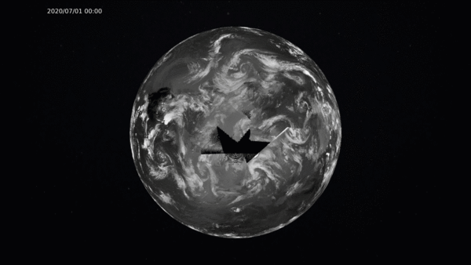
Polar gaps in ISCCP-NG L1g
In the ESA Cloud_cci+ project a new activity has just been kicked-off that conducts feasibility studies on filling the polar gaps in L1g data with LEO data.
Different missions and merging approaches will be considered
4 months of prototype, true-global L1g data are planned to be made available until end of 2025
New sets of spectral band adjustment coefficients will be determined including geo-ring and polar missions
Geo-ring
Very preliminary results for the Arctic: 72h animation of geo-ring 11µm L1g data filled with 4 AVHRRs.
Geo-ring + 4 AVHRRs

