Slide 1
L1g* Update
02.03.2026

Slide 2
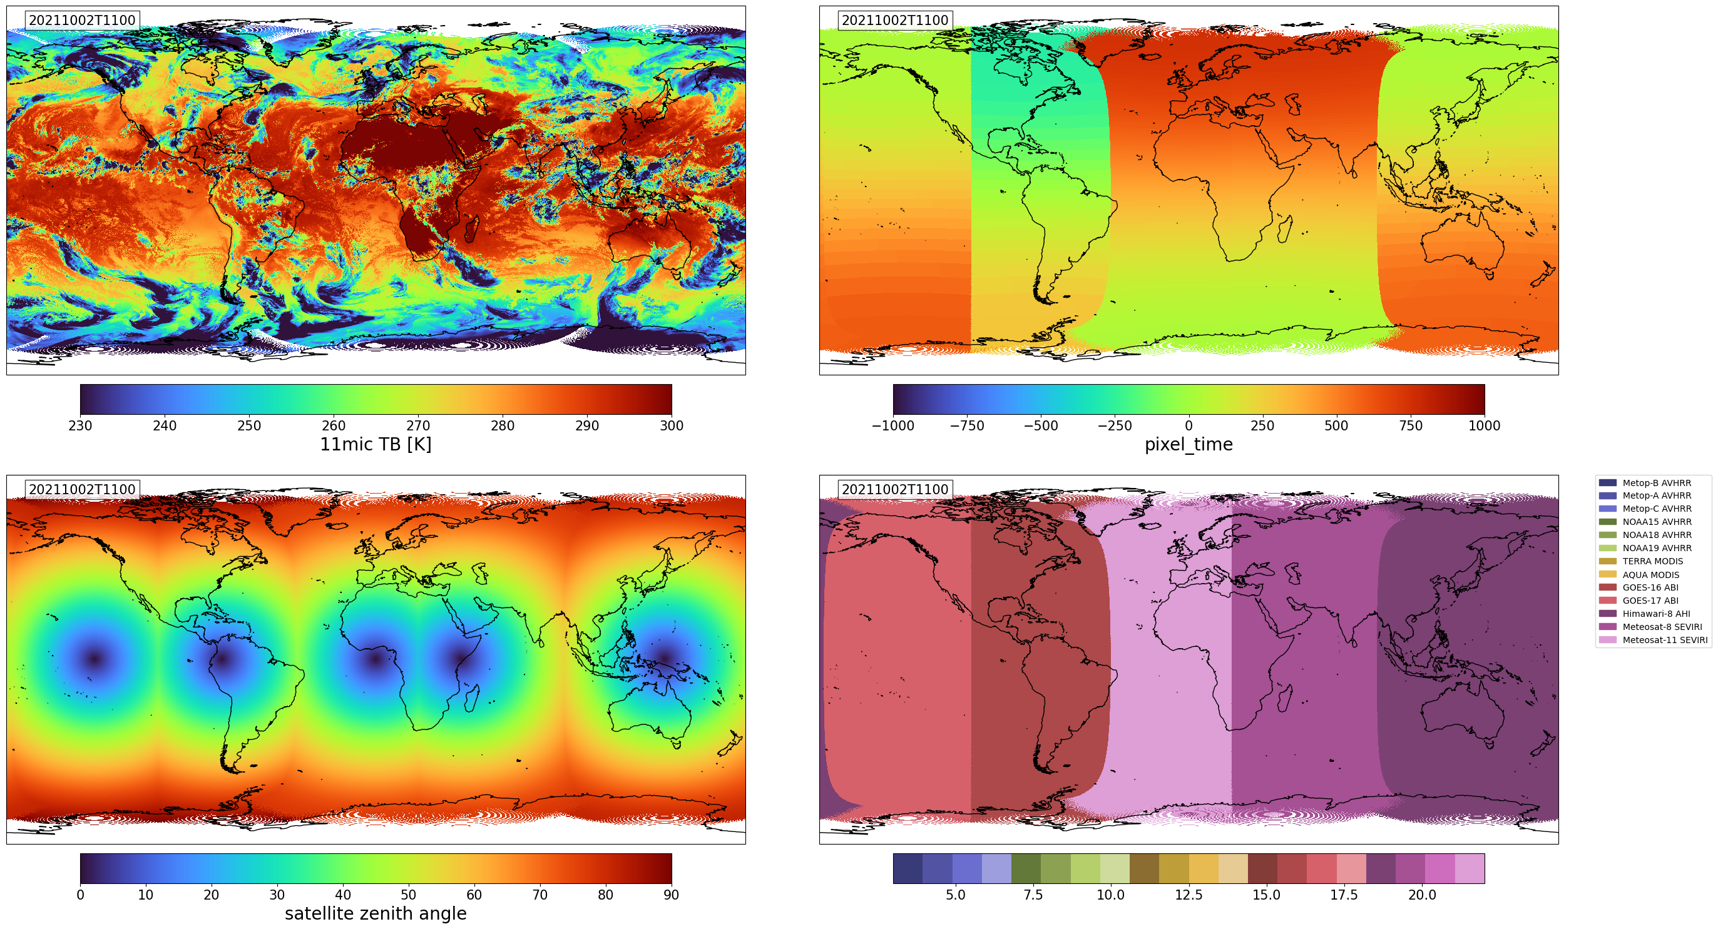
ISCCP-NG
NG Geo-Ring L1g
GOES-16, GOES-17, Himawari-8, Meteosat-8 and Meteosat-11
uniform geographic grid at 0.05° spatial resolution (approximately 5.6 km at the equator) with 30-minute temporal resolution
3 layers

Slide 3
Candidate Polar orbiting data
Polar-orbiting
Nom Wvl | GOES/ ABI | GOES/ GXI | MSG/ SEVIRI | MTG/FCI | FY4/ AGRI | GK2A/ AMI | HIM8/9 AHI | HIM10/ AHI | NOAAs/Metops AVHRR 2900km | Aqua/Terra MODIS 2230km | SLSTR S3a+S3b 1400km | SNPP/NOAA VIIRS/VGAC¹ 3000km | Metops IASI² 2130km
0.47 | 1 | 0.5 |  | 1 | 1 | 1 | 1 | 0.5 |  | 0.5
0.51 |  |  |  | 1 |  | 1 | 1 | 0.5 |  | 0.5 | 0.5
0.65 | 0.5 | 0.25 | 3 | 0.5 | 0.5 | 0.5 | 0.5 | 0.25 | 3x1 | 0.25/1 | 0.5 | 3x1
0.86 | 1 | 0.5 | 3 | 1 | 1 | 1 | 1 | 0.5 | 3x1 | 1 | 0.5 | 3x1
0.91 |  | 1 |  | 1 |  |  |  | 1 |  | 1
1.38 | 2 | 1 |  | 1 | 2 | 1 |  | 1 |  | 1 | 0.5
1.6 | 1 | 1 | 3 | 1 | 2 | 1 | 1 | 1 | 3x1 | 0.5/1 | 0.5 | 3x1
2.2 | 2 | 1 |  | 0.5 | 2 |  | 1 | 1 |  | 0.5 | 0.5
3.8 | 2 | 1 | 3 | 1 | 4 | 2 | 2 | 1 | 3x1 | 1/1 | 1 | 3x1 | 12/24
5.2 |  | 1 |  |  |  |  |  | 1 |  |  |  |  | 12/24
6.2 | 2 | 2 | 3 | 2 | 4 | 2 | 2 | 2 |  |  |  |  | 12/24
6.9 | 2 | 2 |  |  |  | 2 | 2 | 2 |  | 1 |  |  | 12/24
7.3 | 2 | 2 | 3 | 2 | 4 | 2 | 2 | 2 |  | 1 |  |  | 12/24
8.5 | 2 | 2 | 3 | 2 | 4 | 2 | 2 | 2 |  | 1 |  |  | 12/24
9.6 | 2 | 2 | 3 | 2 |  | 2 | 2 | 2 |  | 1 |  |  | 12/24
10.5 | 2 | 2 | 3 | 1 |  | 2 | 2 | 1 |  |  |  |  | 12/24
11.0 | 2 | 2 |  |  | 4 | 2 | 2 | 2 | 3x1 | 1 | 1 | 3x1 | 12/24
12.0 | 2 | 2 | 3 | 2 | 4 | 2 | 2 | 2 | 3x1 | 1 | 1 | 3x1 | 12/24
13.3 | 2 | 2 | 3 | 2 | 4 | 2 | 2 | 2 |  | 1 |  |  | 12/24
¹ Generated from VIIRS data to emulate AVHRR measurements (data used coming from CMSAF including NOAA-19 like SBA)
² Possible to generate imager like IR measurements von convolution of SRFs over IASI spectrum
Table extended from Heidinger et al., BAMS, 2025)

Slide 4
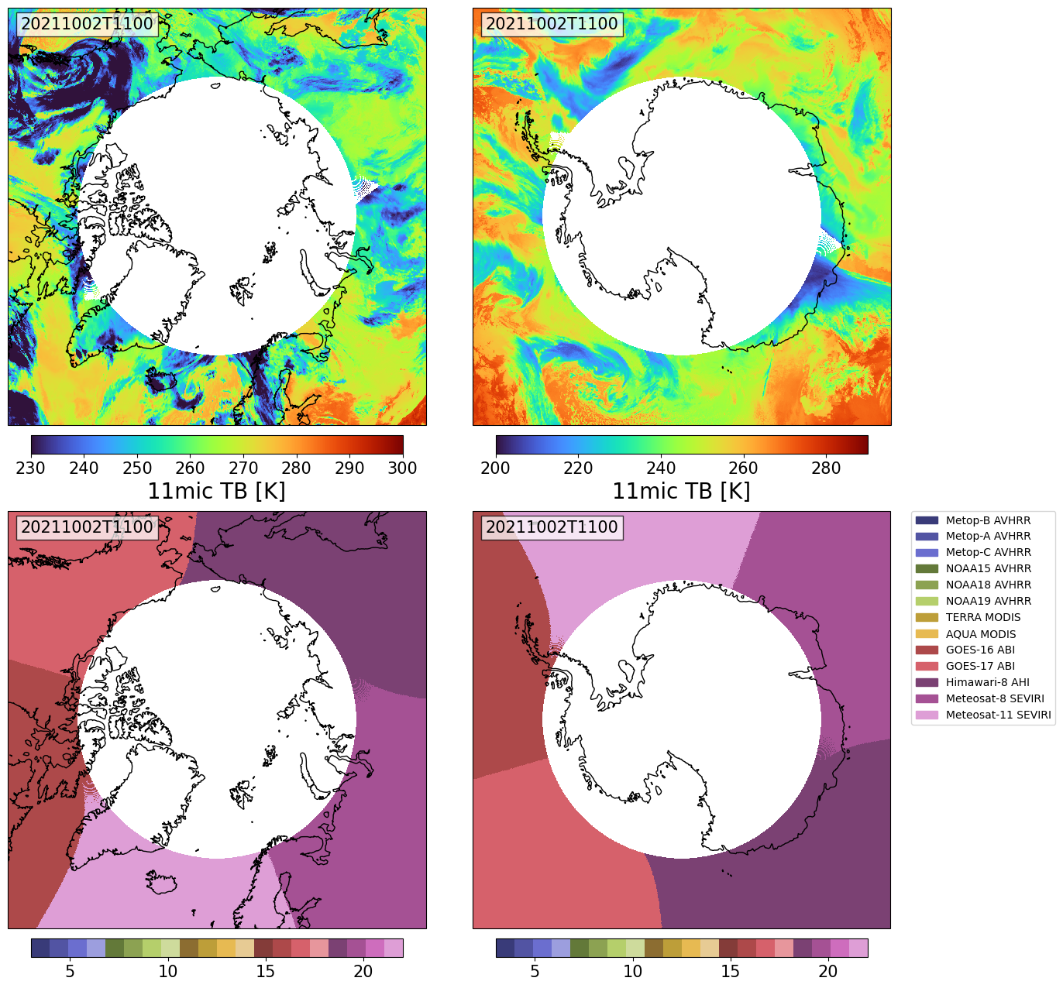
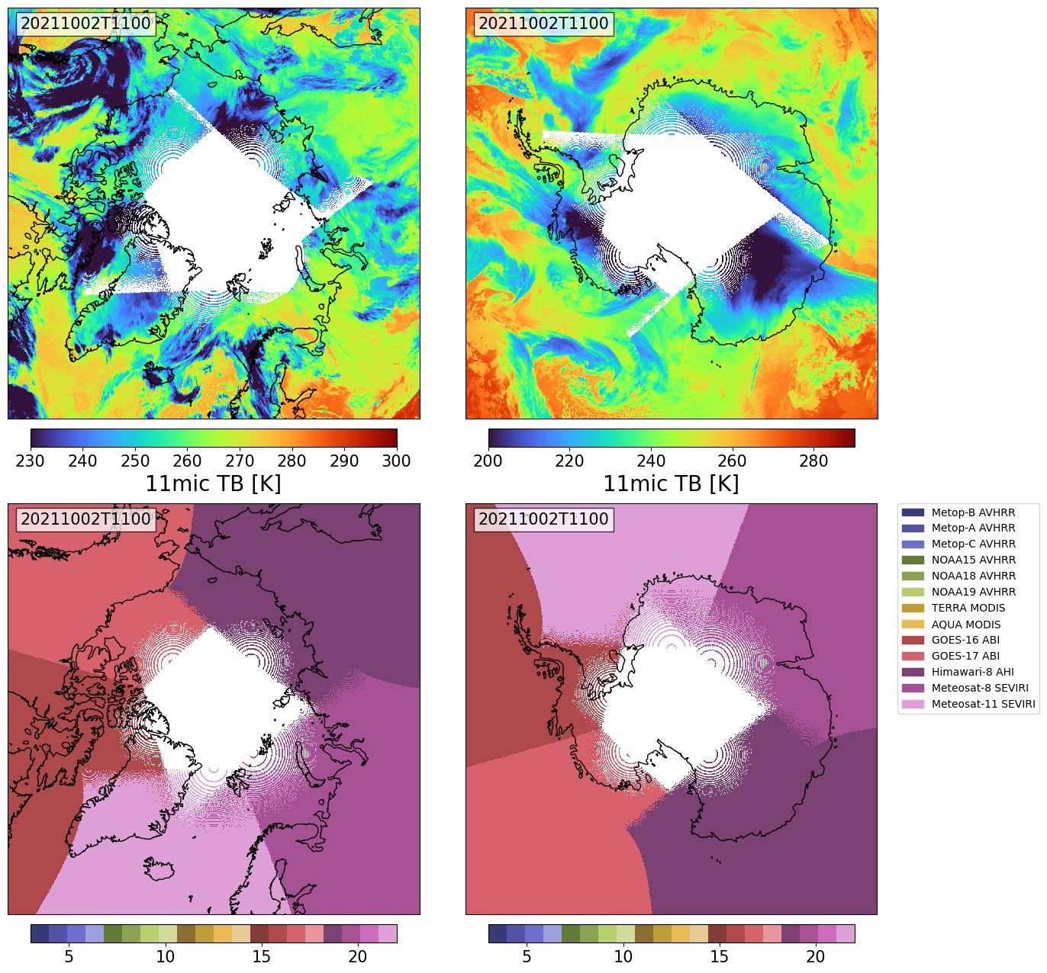
Data Structure

Slide 5
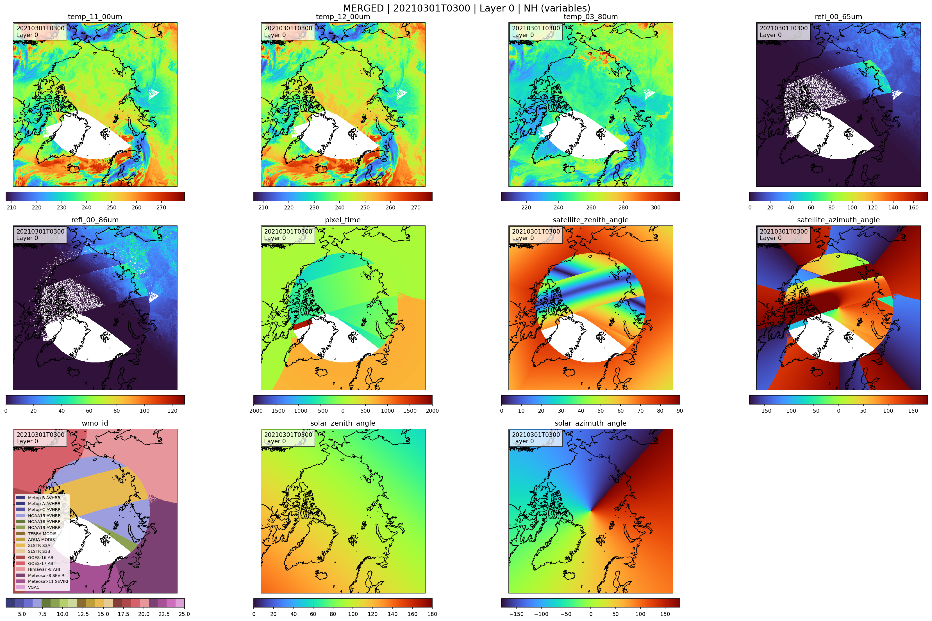
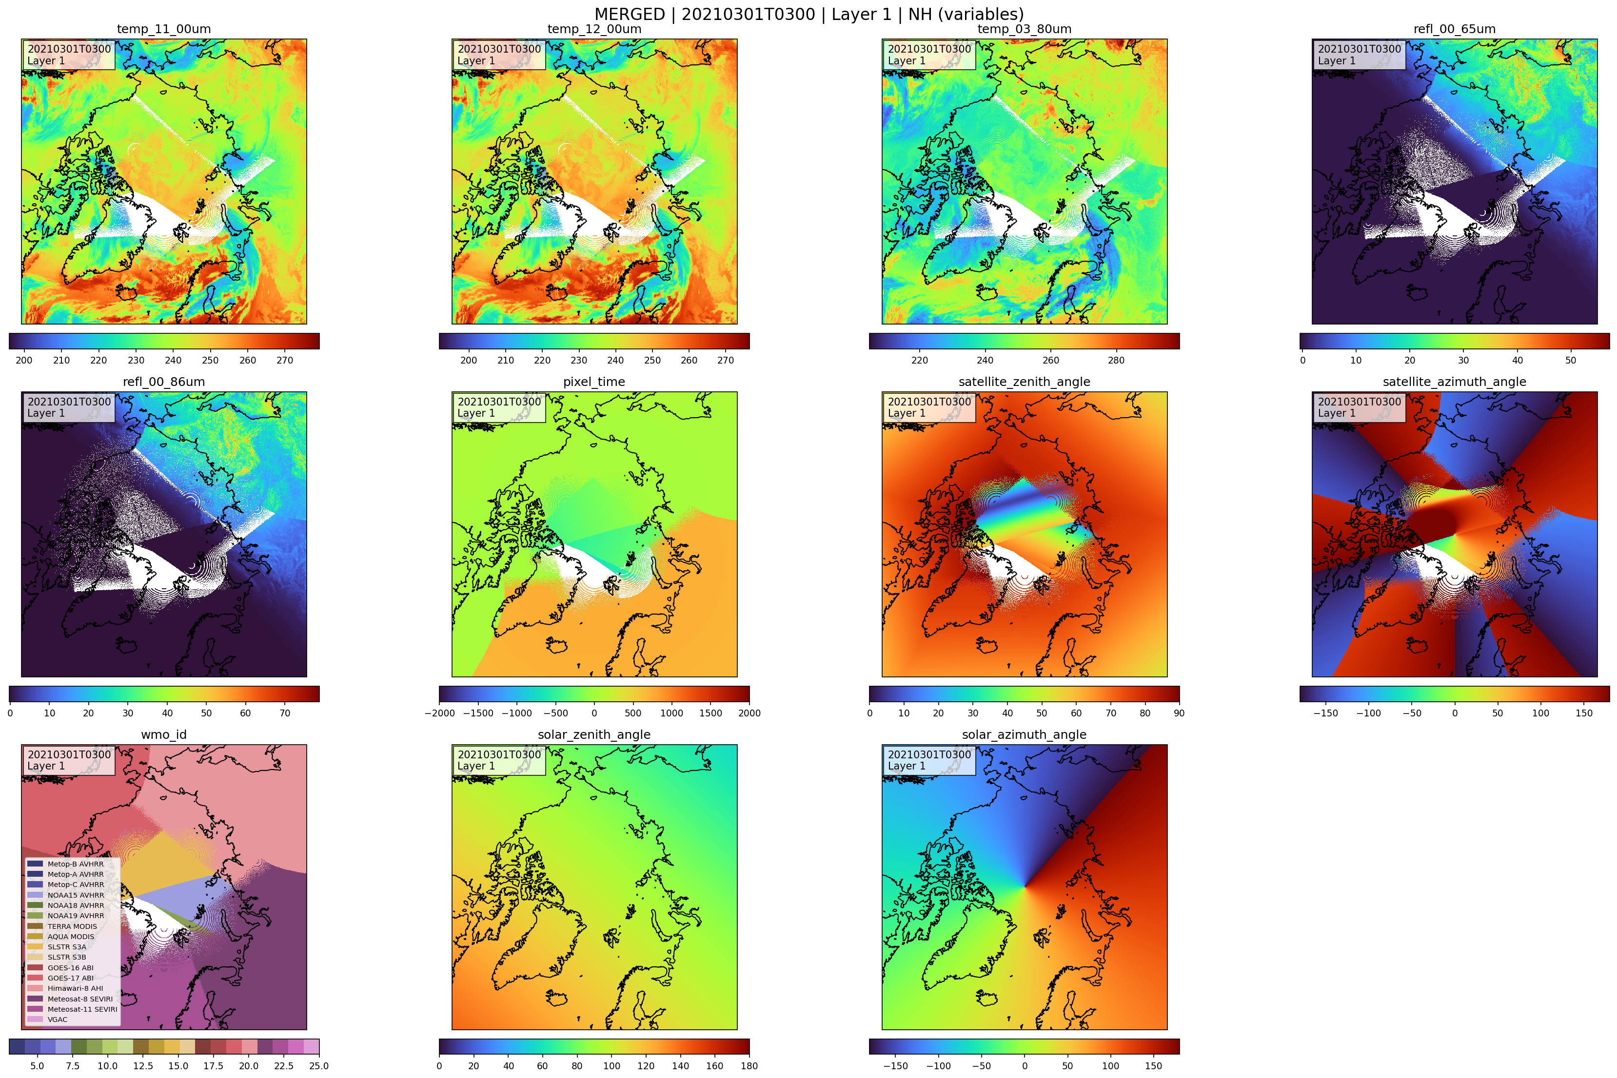
Data structure

Slide 6
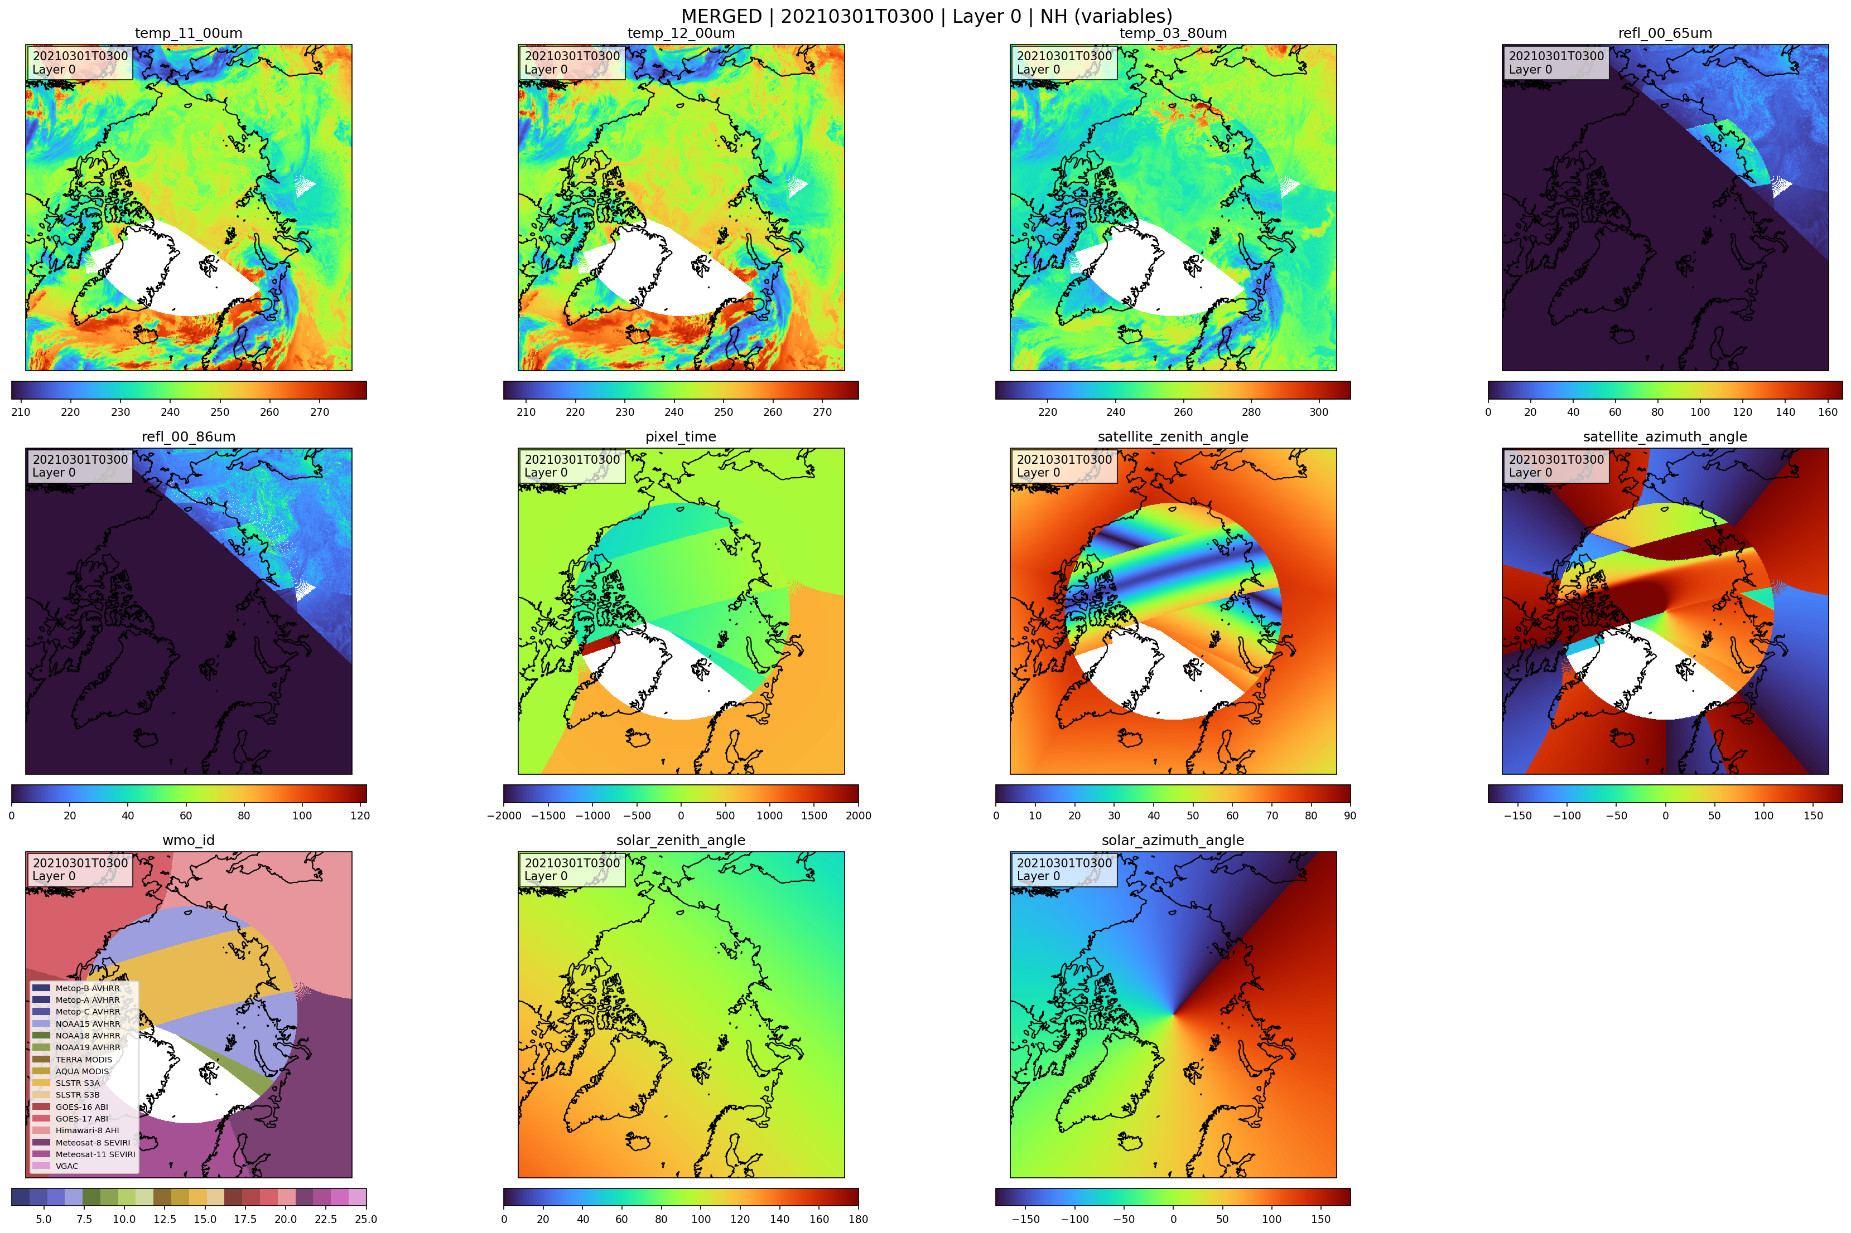
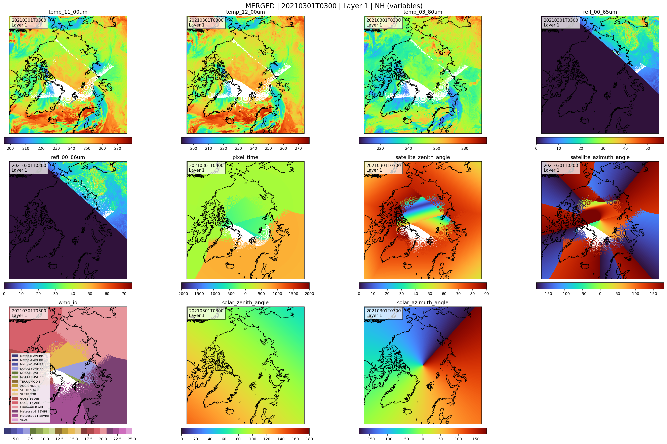
Data Structure

Slide 7
To Discuss
Reflection = 0 at night for all pixels or measurements?
L2: Mask 11um to loose gaps, where GEO doesnt provide measurements?

